Slide 1
Web Applications Basics

Slide 2

Introduction to Web
Web features
  Clent/Server
  HTTP
  HyperText Markup Language
  URL addresses
Web server - a computer program that is responsible for accepting HTTP requests from clients and serving them HTTP responses
Web application - a dynamic extension of a web or application server

Slide 3
Web Applications & Components
Two types of web applications:
  Presentation-oriented (HTML, XML pages)
  Service-oriented (Web services)
Web components provide the dynamic extension capabilities for a web server:
  Java servlets
  JSP pages
  Web service endpoints

Slide 4
Web Application Interaction
[client] sends an HTTP request to the web server
[web server] HTTP request → HTTPServletRequest
This object is delivered to a web component, which can interact with JavaBeans or a DB to generate dynamic content
[web component] generates an HTTPServletResponse or pass the request to another web component
[web server] HTTPServletResponse → HTTP response
[web server] returns HTTP response to the client

Slide 5
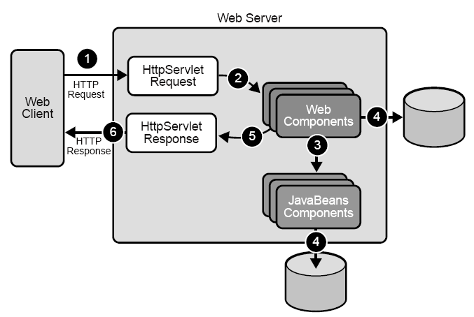
Web Application Interaction

Slide 6
Web Components
Servlets - Java classes that dynamically process requests and construct responses
JSP pages - text-based documents that execute as servlets but allow a more natural approach to creating static content
Appropriate usage
  Servlets - service-oriented applications, control functions
  JSP - generating text-based markup (HTML, SVG, WML, XML)

Slide 7







Web Container Examples
Non-commercial
  Apache Tomcat
  Jetty
Commertial
  Sun Java System Application Server
  BEA WebLogic Server
  Oracle Application Server
  WebSphere
Open source
  JBoss

Slide 8
Deployment
Web components have to be installed or deployed to the web container
Aspects of web application behaviour can be configured during application deployment
The configuration information is maintained in a XML file called a web application deployment descriptor

Slide 9
Web Application Development
A web application consists of:
  Web components
  Static resource files (such as images)
  Helper classes and libraries
The process for creating and running a web application is different from that of traditional stand-alone Java classes

Slide 10
Development Cycle
Develop the web component code
Develop the web application deployment descriptor
Compile the web application components and helper classes referenced by the components
Optionally package the application into a deployable unit
Deploy the application into a web container
Access a URL that references the web application

Slide 11
Resources
J2EE Tutorial “Getting Started with Web applications”
http://java.sun.com/javaee/5/docs/tutorial/doc/bnadr.html
Building Web Applications with Maven 2
http://today.java.net/pub/a/today/2007/03/01/building-web-applications-with-maven-2.html
Filmiņa par Web 2 (5 minūtes)
http://www.youtube.com/watch?v=6gmP4nk0EOE

